Slide 1
Lecture – 11

Slide 2
Booth’s Multiplication Algorithm
It employs both addition and subtraction.
It treats positive and negative operands uniformly.
No special actions are required for negative numbers.
It provides faster execution.

Slide 3
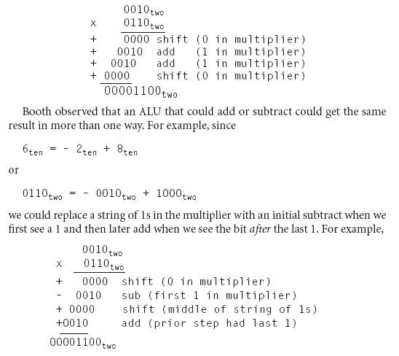
Booth’s Multiplication Algorithm

Slide 4
Booth’s Multiplication Algorithm
Step – 1:
Two adjacent bits x_{i}x_{i-1} are examined in each step.
If x_{i}x_{i-1} =01, then Y is added to the current partial product P_{i}.
If x_{i}x_{i-1} =10, then Y is subtracted from P_{i}.
If x_{i}x_{i-1} =00 or 11, then neither addition or subtraction is performed.
Step – 2:
Shift the product register right 1 bit.

Slide 5
Booth’s Multiplication Algorithm
It effectively skips over runs of 1s and runs of 0s that it encounters in X.
It reduces the average number of add-subtract steps and allows faster multipliers to be designed.
It involves more complex circuitry.

Slide 6
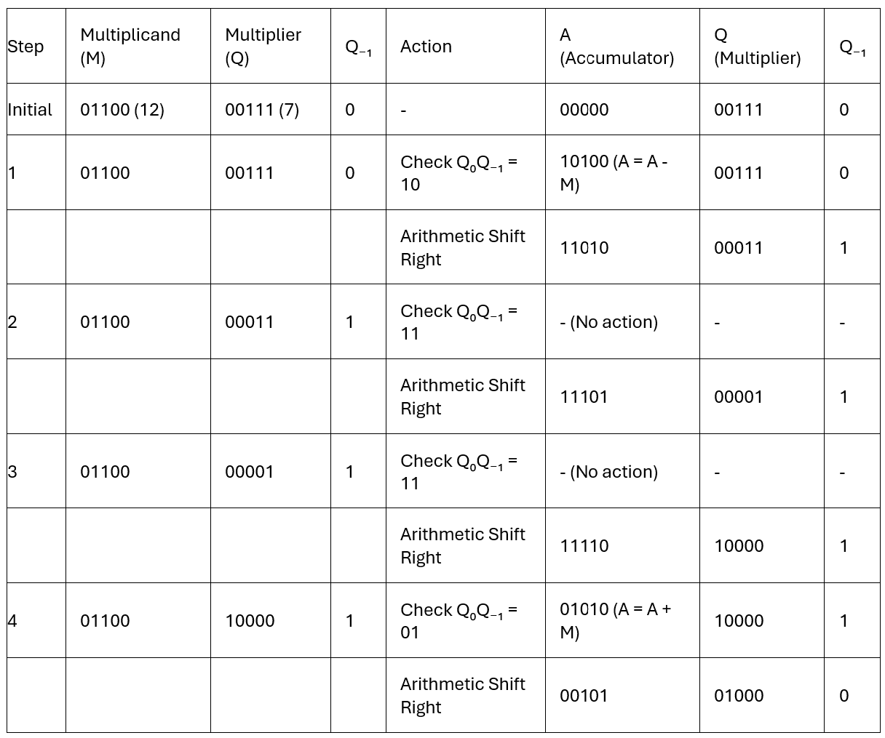
Example
01100₂ X 00111₂

Slide 7
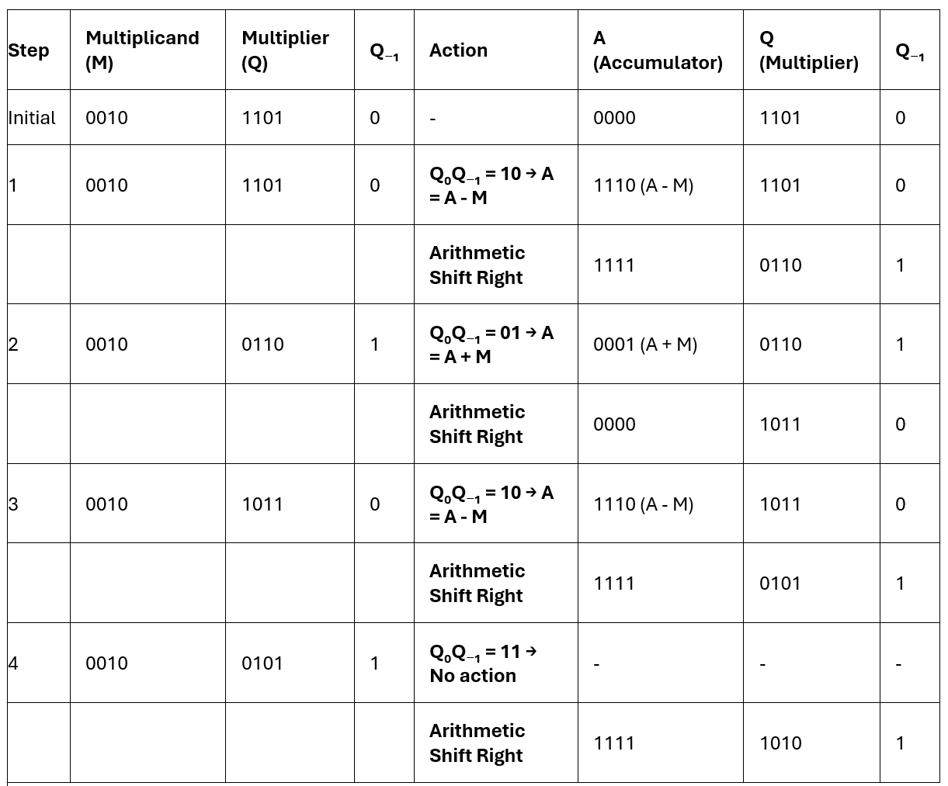
Example
2₁₀ X -3₁₀ = 0010₂ X 1101₂

Slide 8


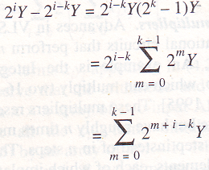

Validity of Booth’s Multiplication Algorithm
Let X is a positive integer and contains a subsequence X* consisting of a run of k 1s flanked by two 0s.
In normal multiplication the contribution of X* to P = X × Y is
In booth’s multiplication, x_{i}x_{i-1} =01 which contributes 2^{i}Y to P.
When x_{i-k}x_{i-k-1} = 10 the contribution is -2^{i-k}Y to P.
So the net contribution is
If j=m+i-k then we get

Slide 9
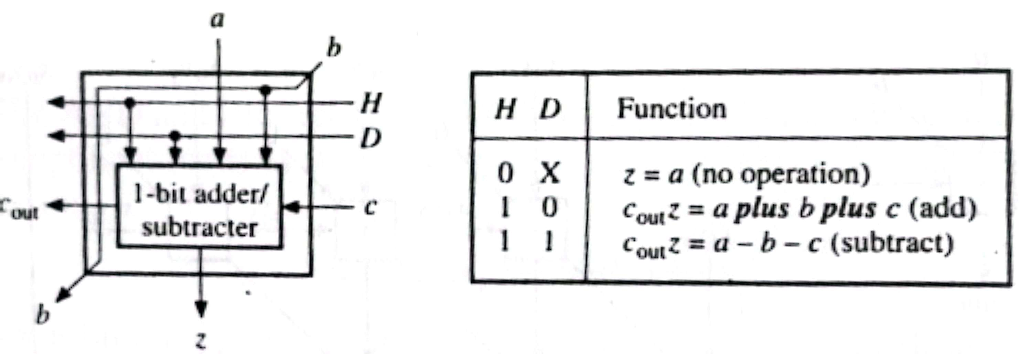
Array Implementation of the Booth Multiplication Algorithm
It requires a multifunction cell capable of addition, subtraction and no operation (skip).
The functions of B are defined by z = a ⊕ bH ⊕ cH and C_{out} = (a ⊕ D)(b+c) + bc

Slide 10
Array Implementation of the Booth Multiplication Algorithm
z = a ⊕ bH ⊕ cH and C_{out} = (a ⊕ D)(b+c) + bc
When HD = 10 the equations reduce to full adder equations.
When HD = 11 the equations reduce to full subtracter equations.
When H = 0 then z = a and carry plays no role in the final result.
A n × n bit multiplier is constructed from n² + n(n-1)/2 cells.

Slide 11
Array Implementation of the Booth Multiplication Algorithm
C cell generates control input H and D required by the B cells depending on the combination of x_{i}x_{i-1}.
x_{i} | x_{i-1} | H | D
0 | 0 | 0 | 0
0 | 1 | 1 | 0
1 | 0 | 1 | 1
1 | 1 | 0 | 0

Slide 12
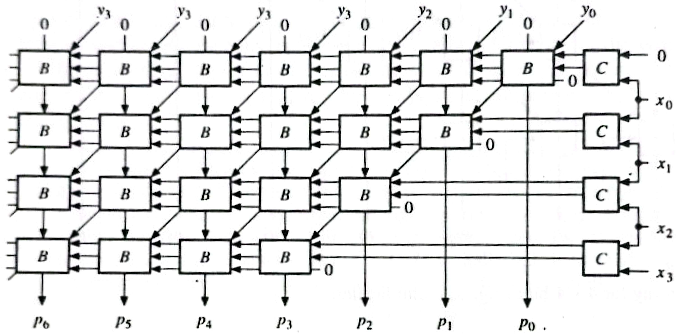
Array Implementation of the Booth Multiplication Algorithm

Slide 13

Floating-Point Addition
9.999 × 10¹ + 1.610 × 10⁻¹. Assume that we can store four decimal digits of the significand and two decimal digits of the exponent.
Step 1: Align the decimal point of the number that has the smaller exponent.
After shifting, the number is
Step 2: Add the significands.
The sum is

Slide 14


Floating-Point Addition
Step 3: Normalize the result.
Check for underflow and overflow.
Step 4: Round the result.
Truncate the number if the digit to the right of the desired point is between 0 and 4. Add 1 to the digit if the number to the right is between 5 and 9.

Slide 15
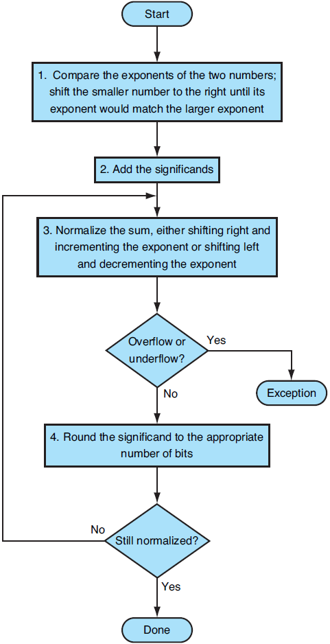
Floating-Point Addition

Slide 16
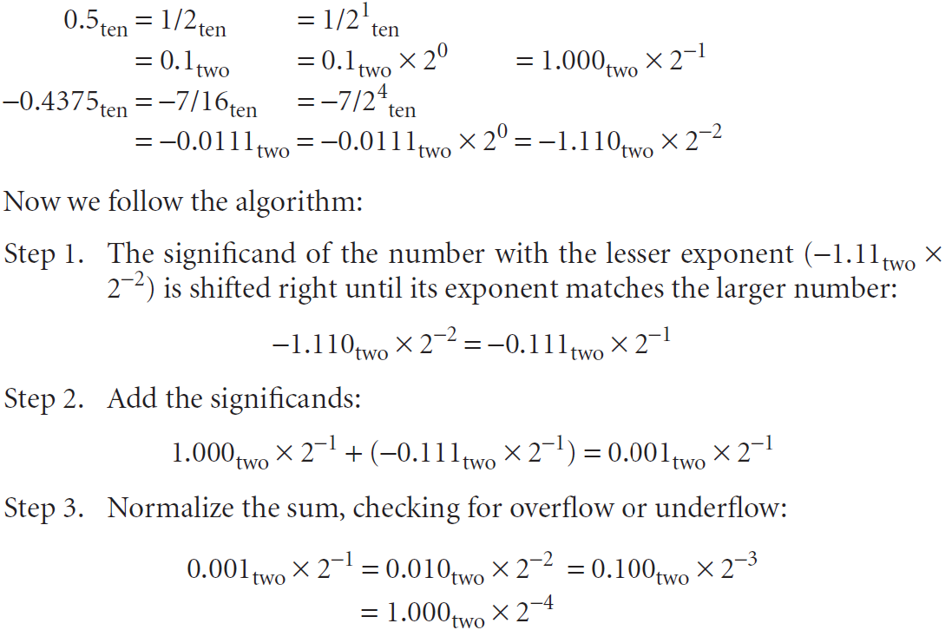
Example of Floating-Point Addition
Add the numbers 0.5 and -0.4375 in binary.

Slide 17
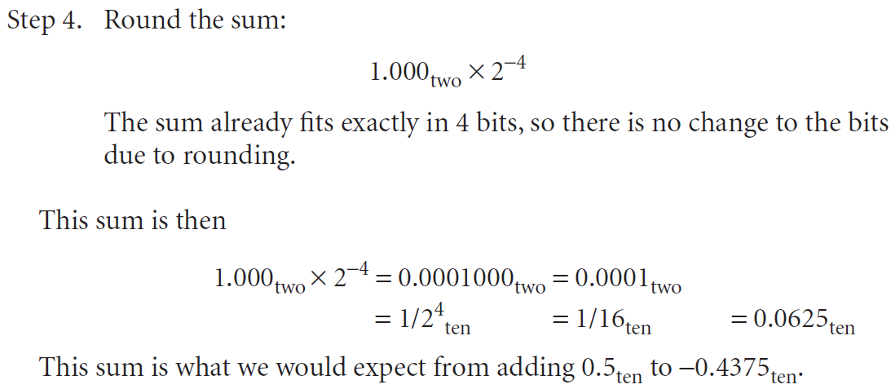
Example of Floating-Point Addition

Slide 18
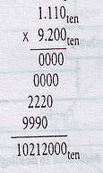
Floating-Point Multiplication
1.110 × 10¹⁰ × 9.200 × 10⁻⁵. Assume that we can store only four digits of the significand and two digits of the exponent.
Step 1: Calculate the exponent of the product by simply adding the exponents of the operands together.
Using the biased notation,
New exponent = (10+127)+(-5+127) – 127
= 137 + 122 – 127
=132 = 5 + 127
Step 2: Multiply significands.
10.212000_{ten} = 10.212 × 10⁵

Slide 19

Floating-Point Multiplication
Step 3: Normalize the product and check for underflow and overflow.
Step 4: The number 1.0212 × 10⁶ is rounded to 1.021 × 10⁶.
Step 5: Set the sign the of the product. The sign of the product depends on the sign of the original operands. If they are both the same, the sign is positive. Otherwise it is negative.
So, the product is + 1.021 × 10⁶

Slide 20
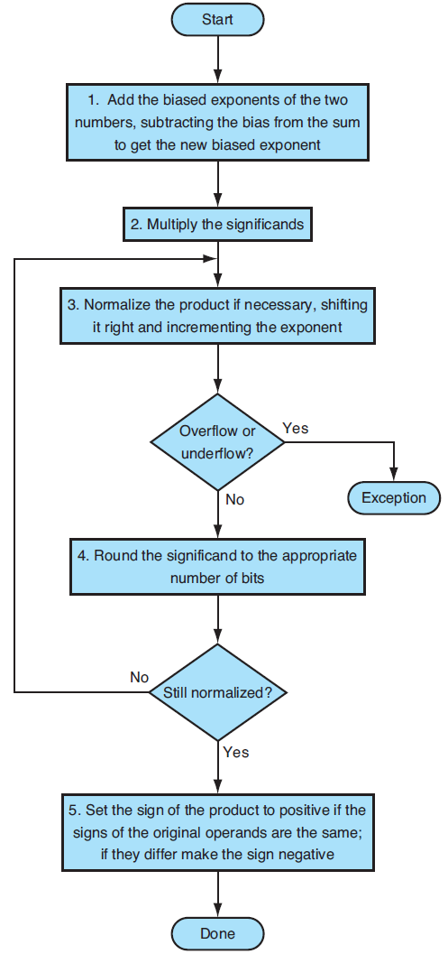
Floating-Point Multiplication

Slide 21
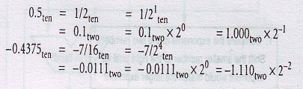
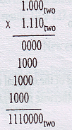
Example of Floating-Point Addition
Multiply the numbers 0.5 and -0.4375 in binary.
Step 1: -1 + (-2) = -3
Using biased representation,
(-1+127) + (-2+127) – 127 = -3 + 127 = 124
Step 2:
The product is 1.11000 × 2⁻³ = 1.110 × 2⁻³

Slide 22
Example of Floating-Point Multiplication
Step 3: The product is normalized and there is no overflow and underflow.
Step 4: It is already rounded.
Step 5: The signs of the original operands are different. So the sign of the product is negative. So the Final product is
- 1.110 × 2⁻³
= - 0.21875

